Slide 1

MAT205: Abstract Algebra II
6. Free abelian groups
Ma, Jia-Jun

Slide 2

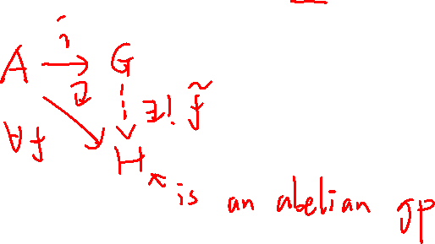
Definition of free Abelian group by Universal property
Let $G$ be an abelian group, $A$ be a subset of $G$.
We say $G$ is a free abelian group with basis $A$ if the following universal property holds:

Slide 3
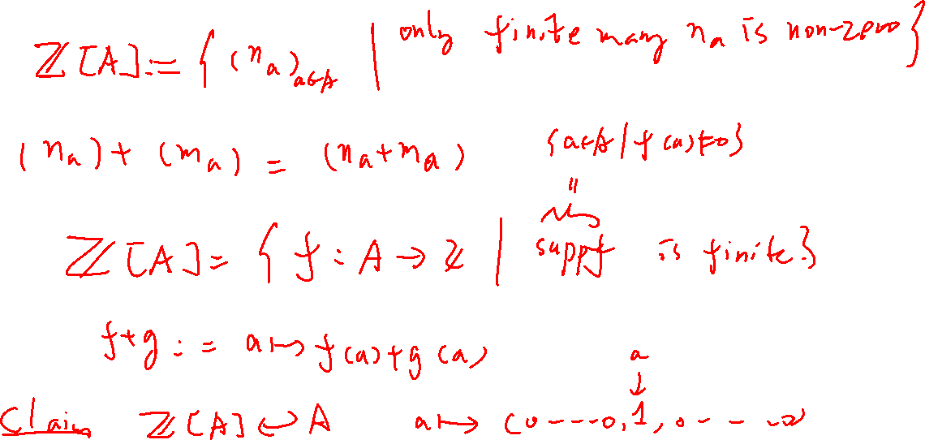
The model of a free abelian group

Slide 4
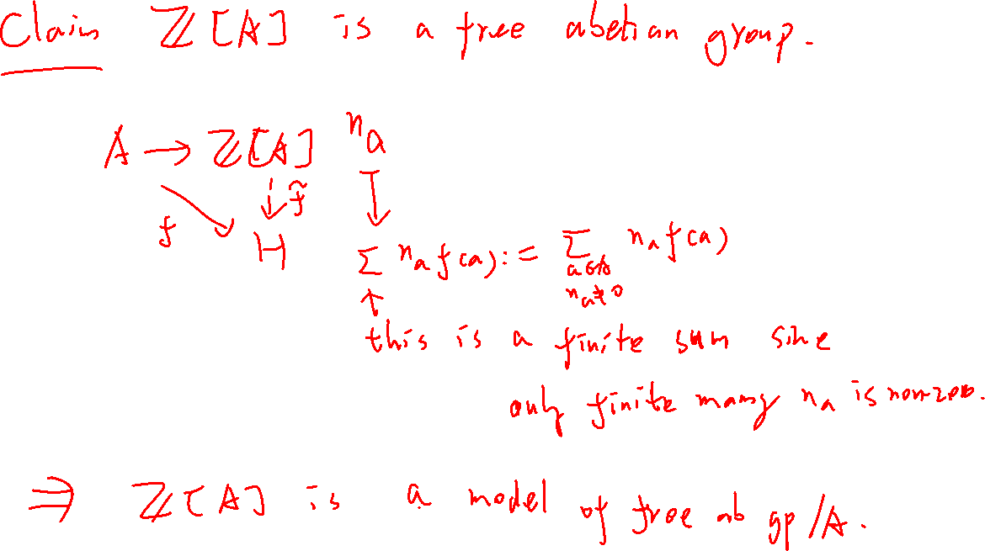

Slide 5
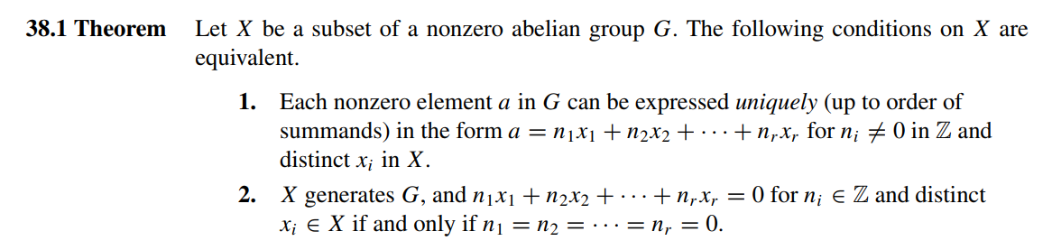
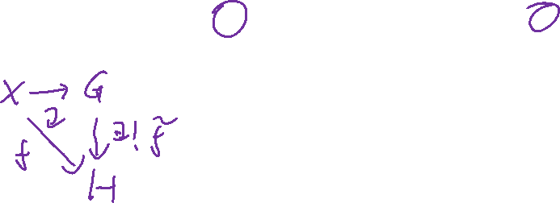
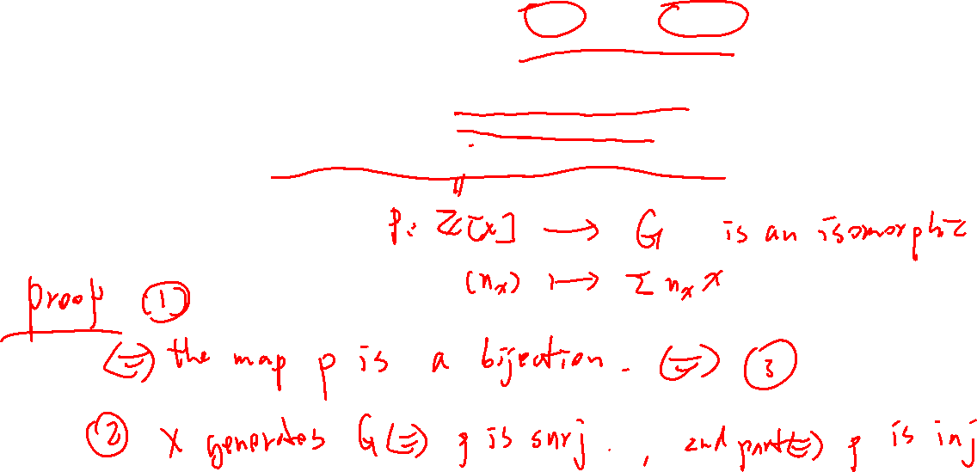
3. The natural map $ℤ[X]→G$ is an isomorphism.

Slide 6
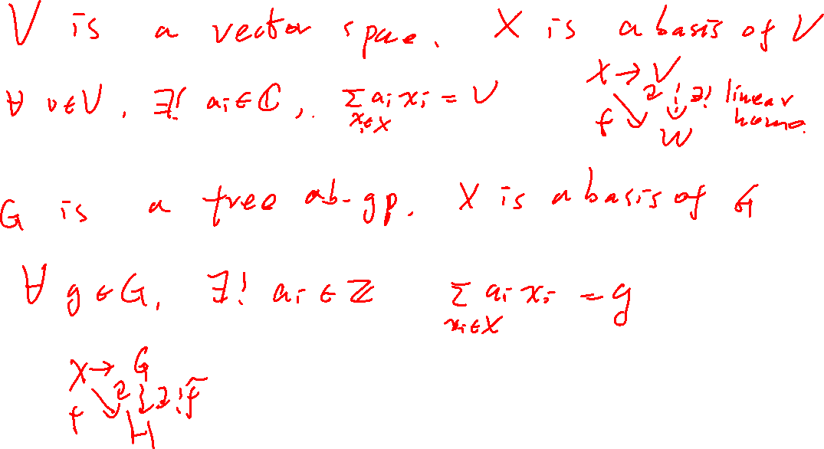

Slide 7
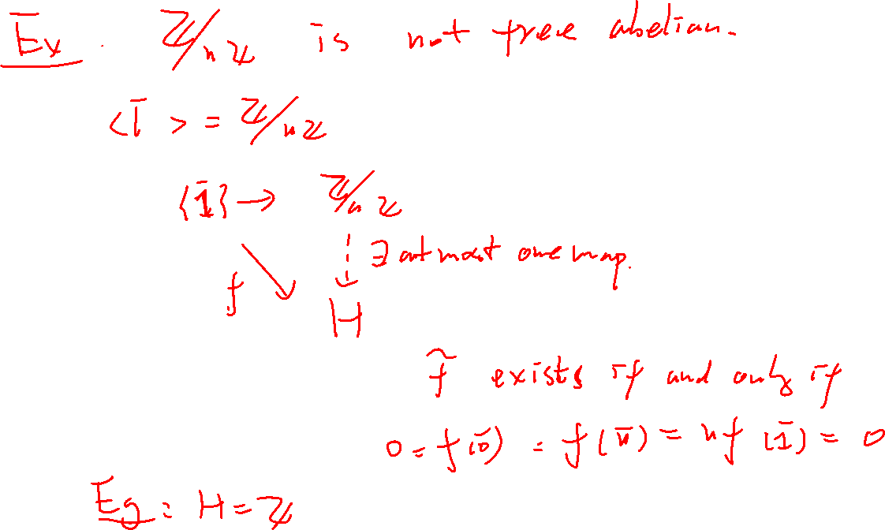

Slide 8
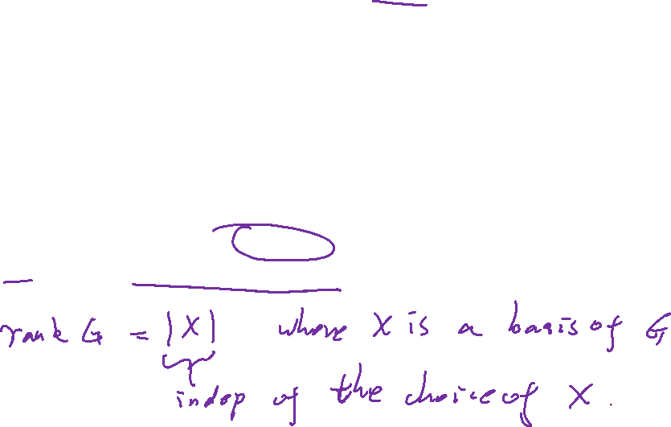

Slide 9
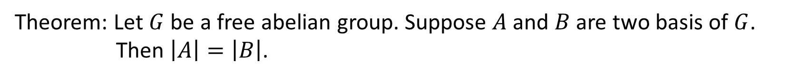

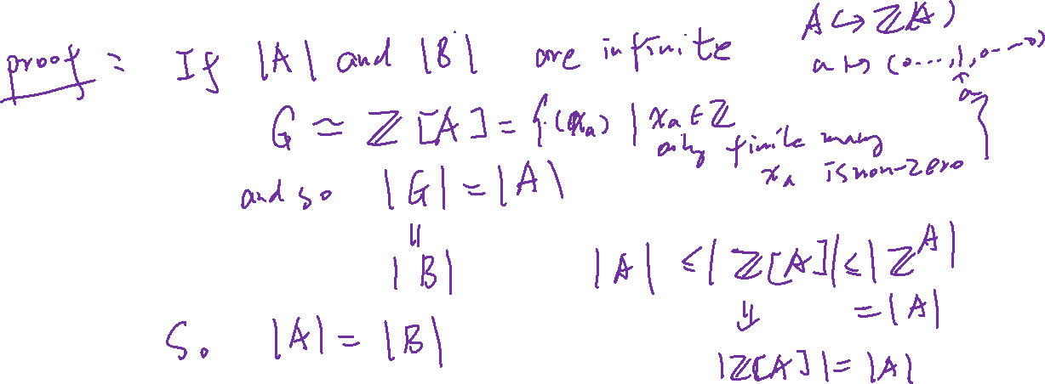
Theorem: Let $G$ be a free abelian group. Suppose $A$ and $B$ are two basis of $G$.
Then $\left|A\right|=\left|B\right|$.

Slide 10
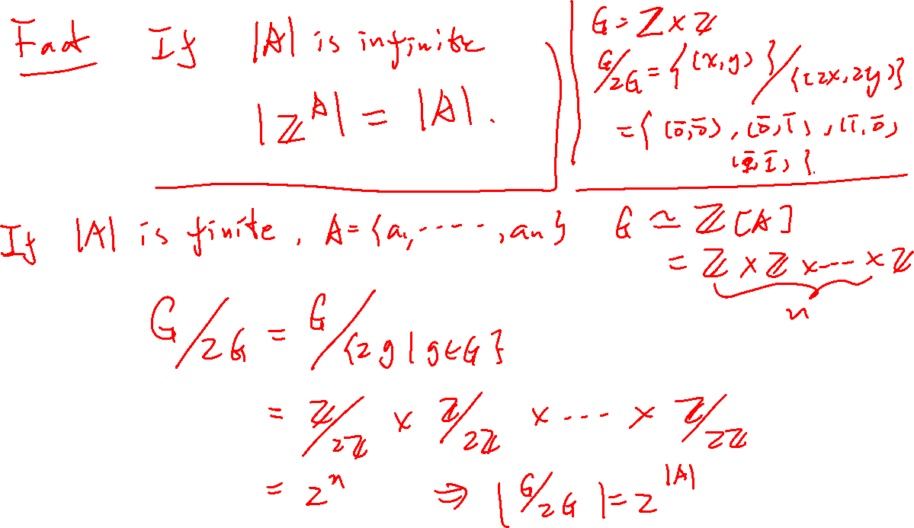

Slide 11
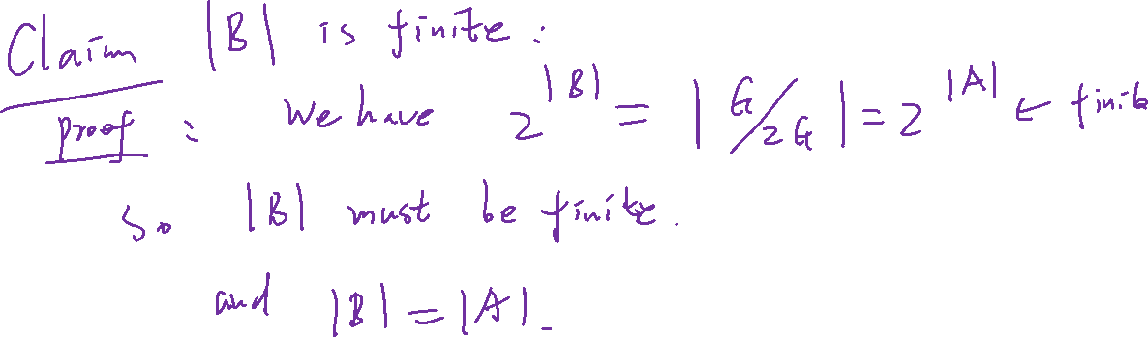

Slide 12
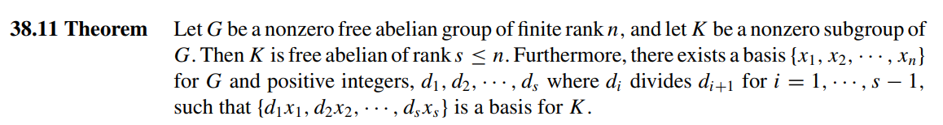
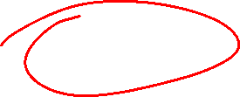
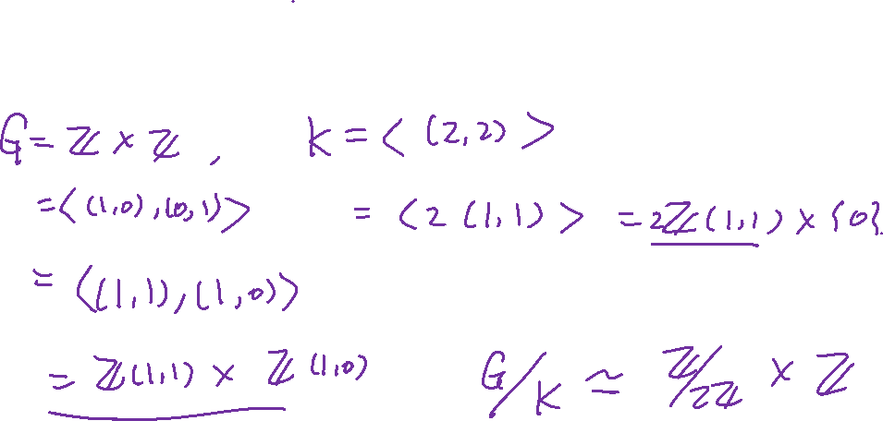
Example:

Slide 13
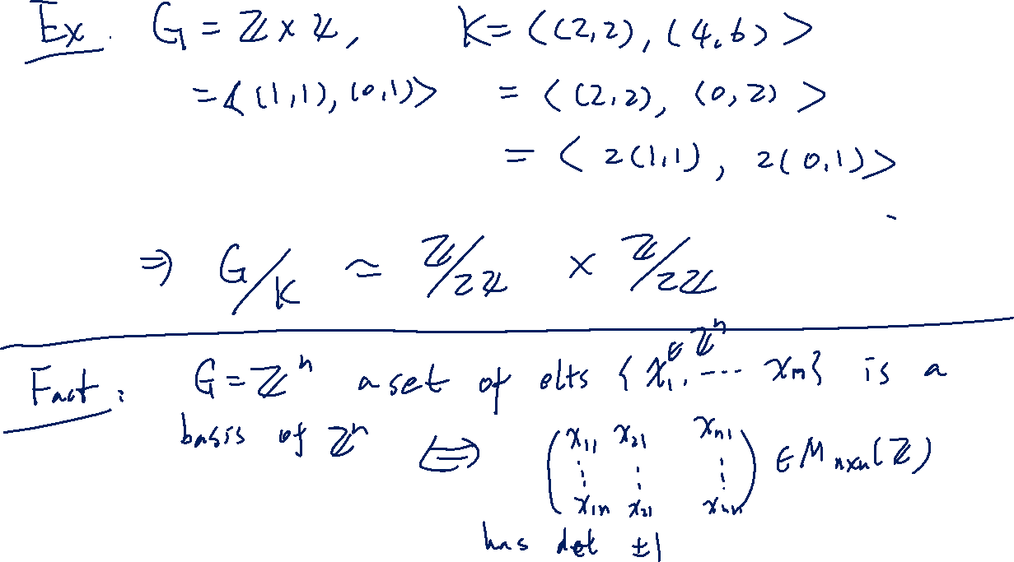


Slide 14
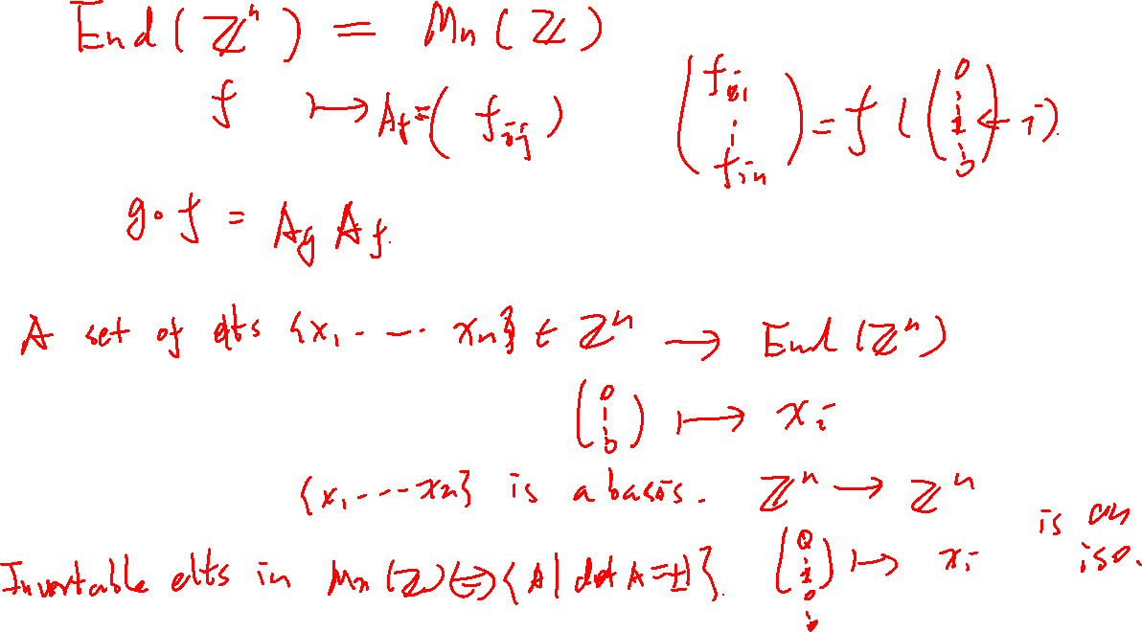

Slide 15
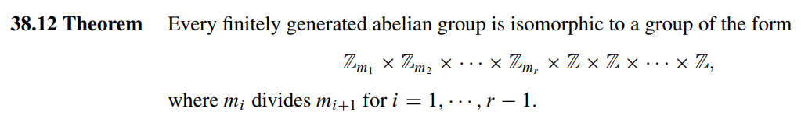
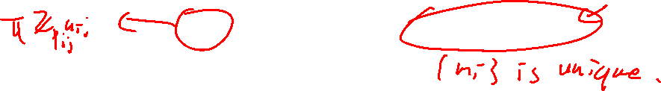
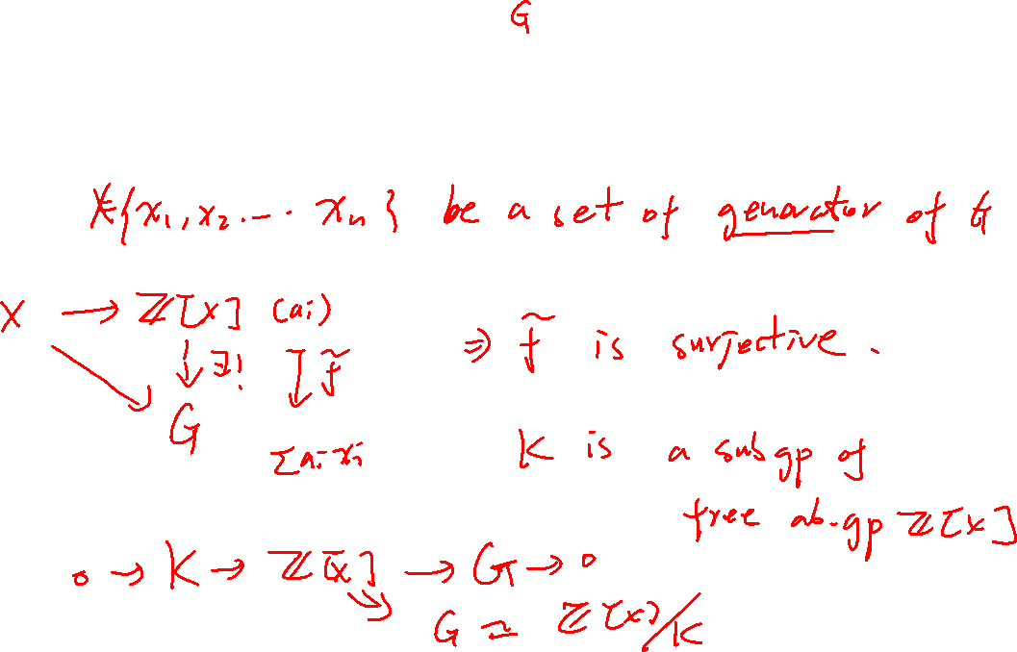


Slide 16
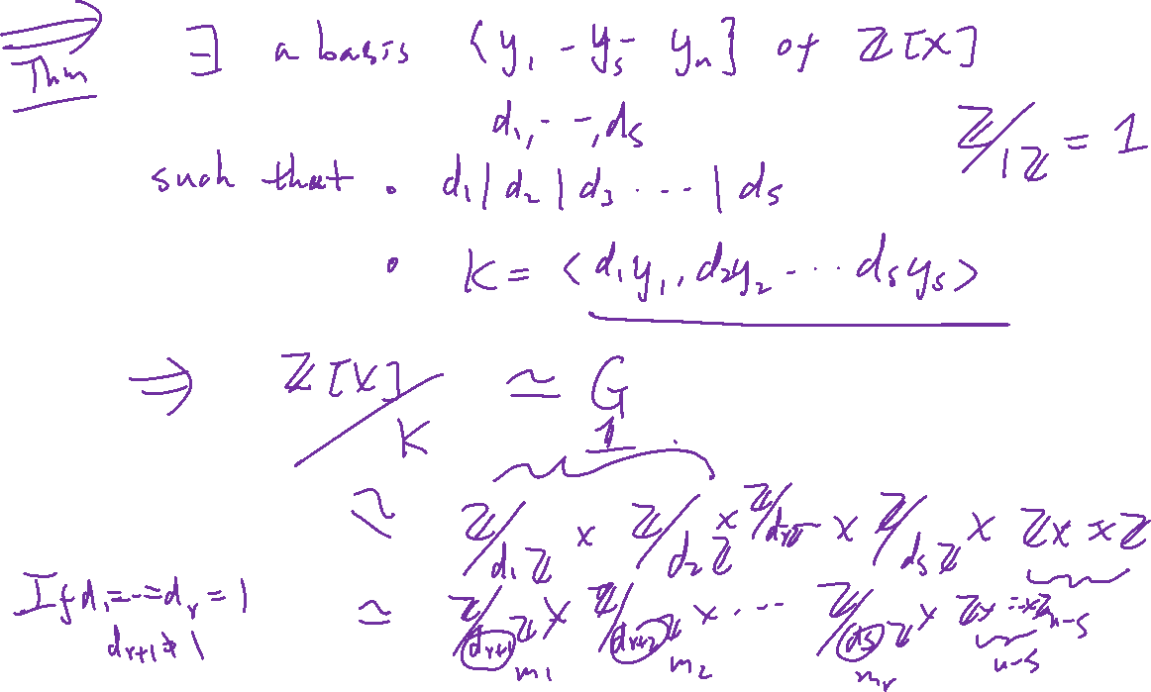

Slide 17
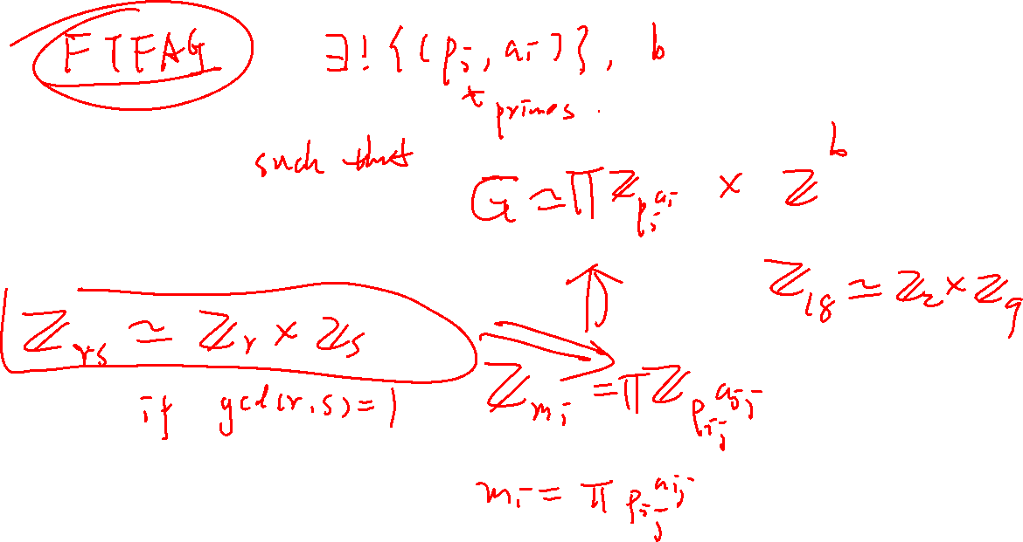

Slide 18
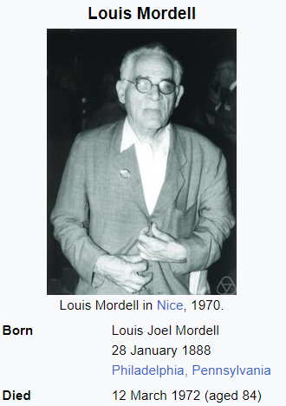
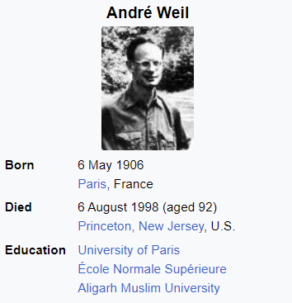
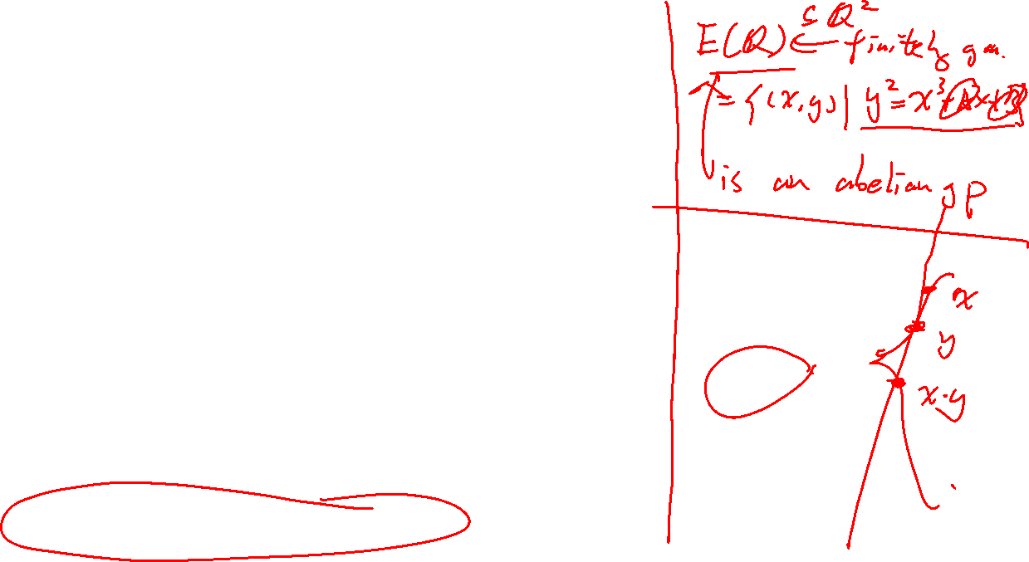
https://en.wikipedia.org/wiki/Rank_of_an_elliptic_curve
Birch and Swinnerton-Dyer conjecture

Slide 19


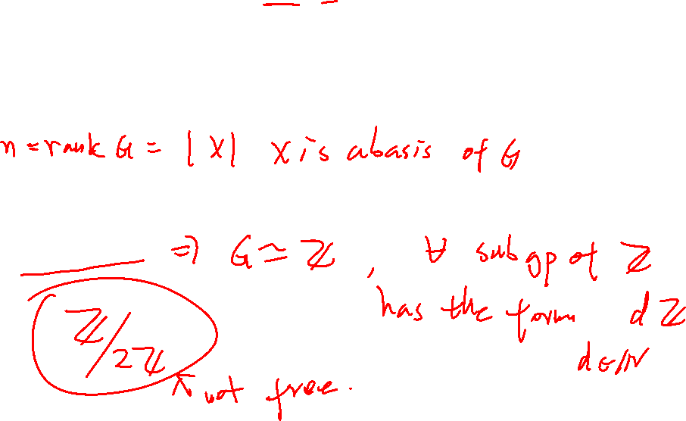

Proof by induction on the rank of $G$.
Initial case: rank $G$ = 1

Slide 20
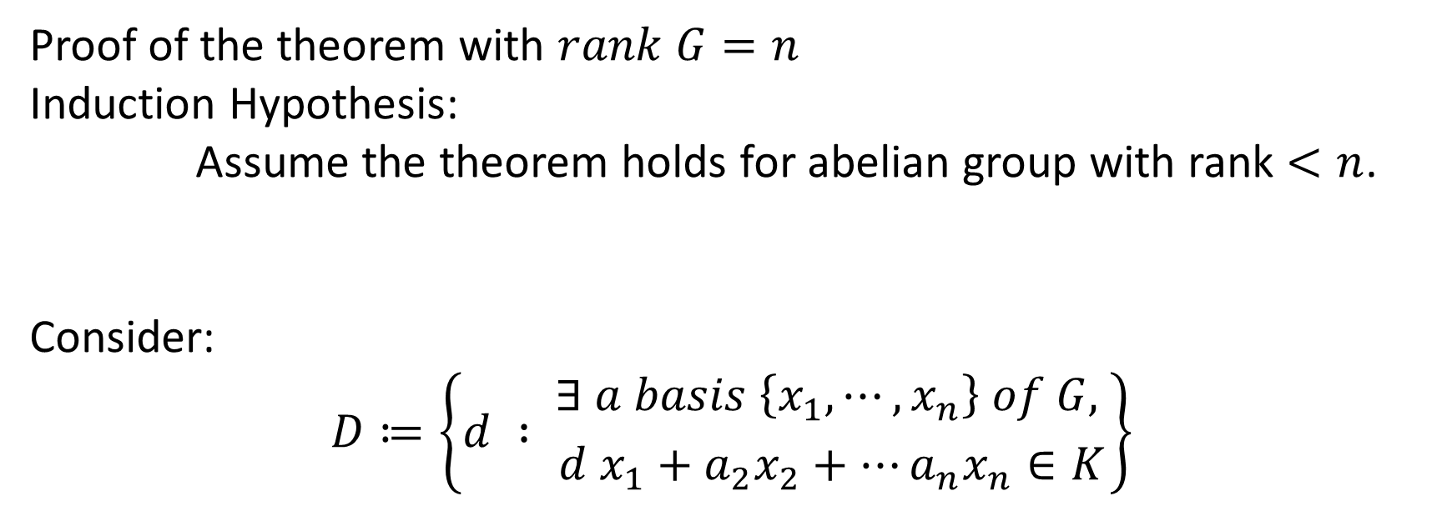
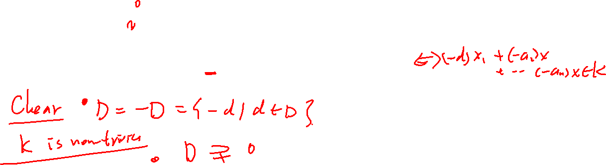
Proof of the theorem with $rank G=n$
Induction Hypothesis:
Assume the theorem holds for abelian group with rank $<n$.
Consider:
$$D≔\left\{d : {∃ a basis \left\{x_{1},⋯, x_{n}\right\} of G, \atop d x_{1}+a_{2}x_{2}+⋯a_{n}x_{n}∈K}\right\}$$

Slide 21
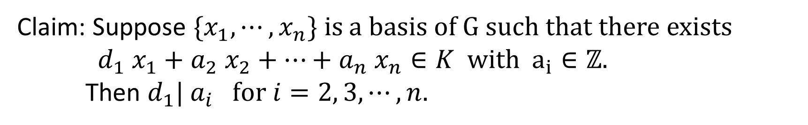
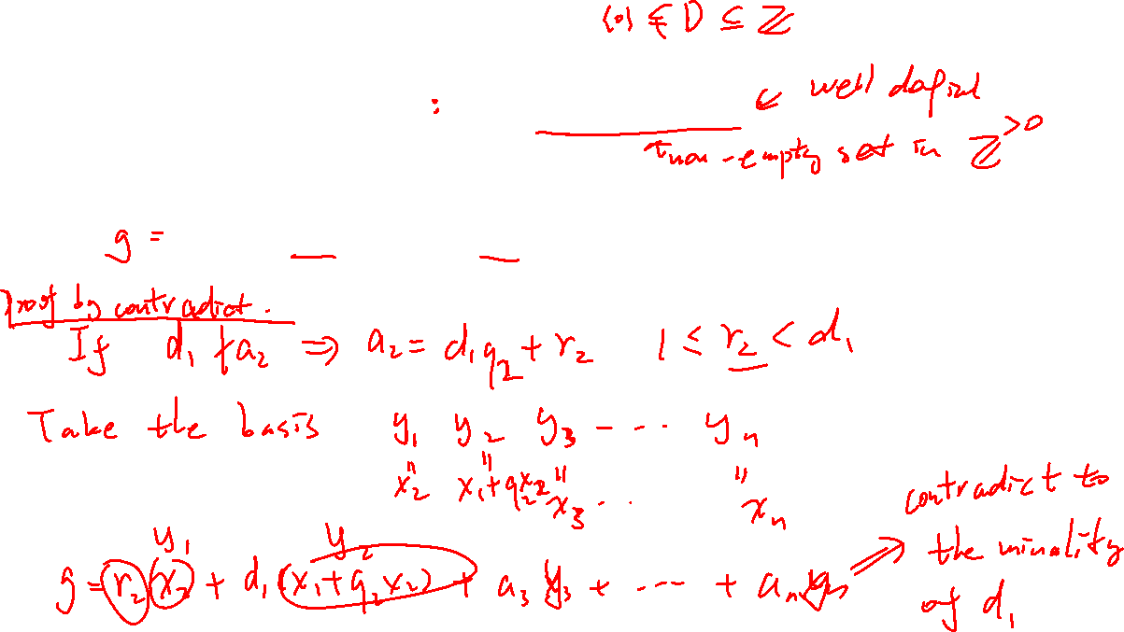

Define
$$d_{1}=\min\left\{d>0\right|d∈D \}$$
Claim: Suppose $\{x_{1},⋯,x_{n}\}$ is a basis of $G$ such that there exists
$d_{1} x_{1}+a_{2} x_{2}+⋯+a_{n} x_{n}∈K$ with $a_{i}∈ℤ.$
Then $d_{1}| a_{i} for i=2, 3, ⋯,n.$

Slide 22
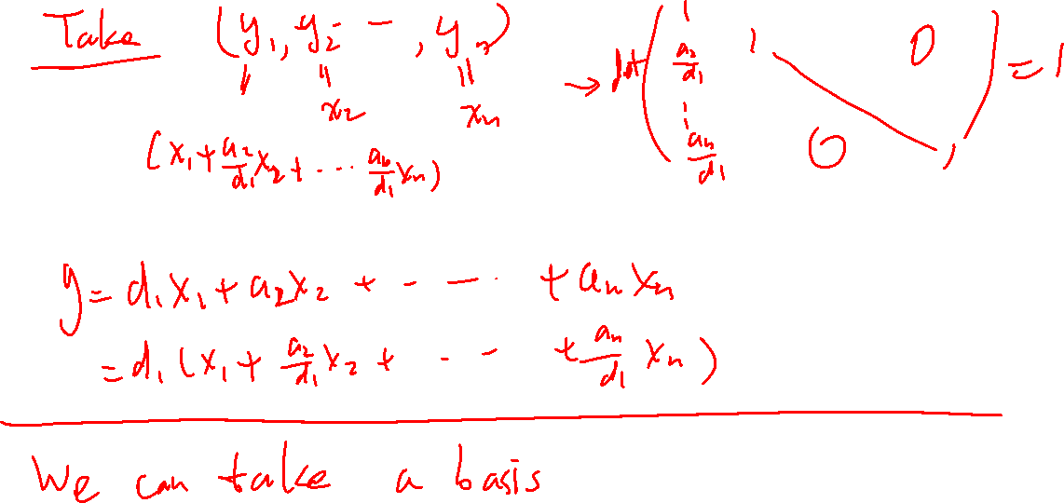


Slide 23

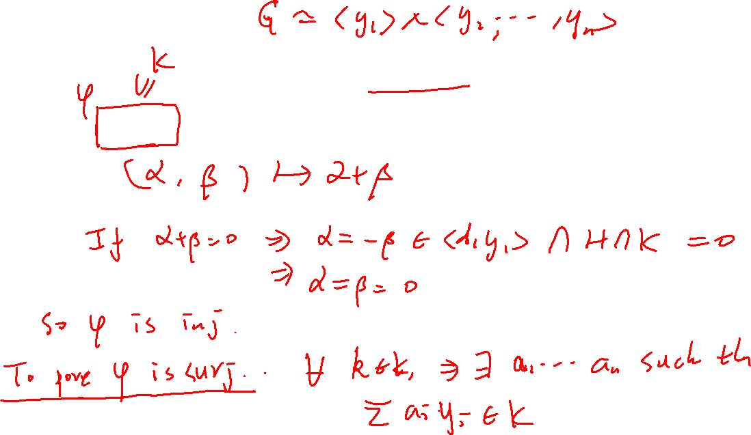
Define
$$H=\left\langle y_{2}, ⋯,y_{n}\right\rangle$$
Claim: $\left\langle d_{1} y_{1}\right\rangle ×\left(H∩K\right)→K$is an isomorphism.

Slide 24
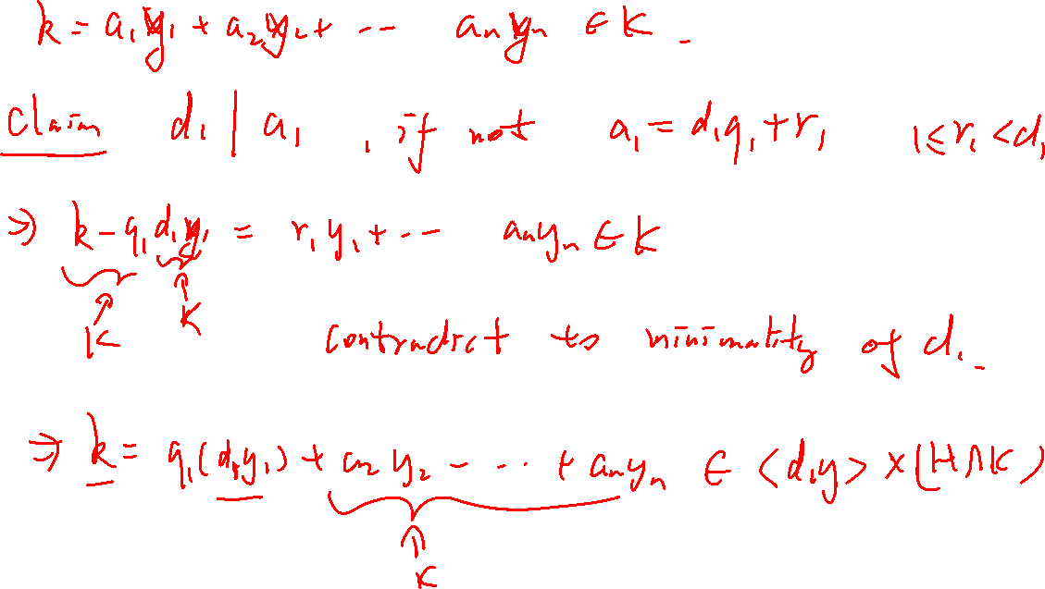

Slide 26

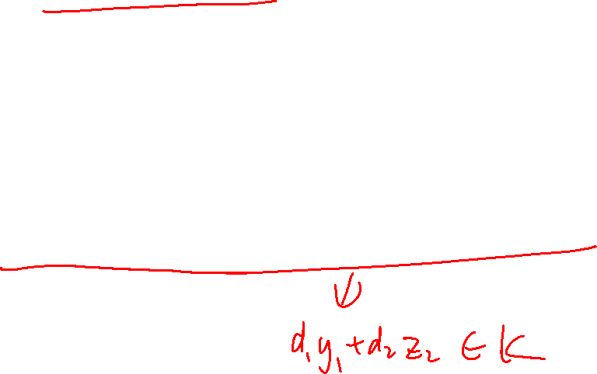
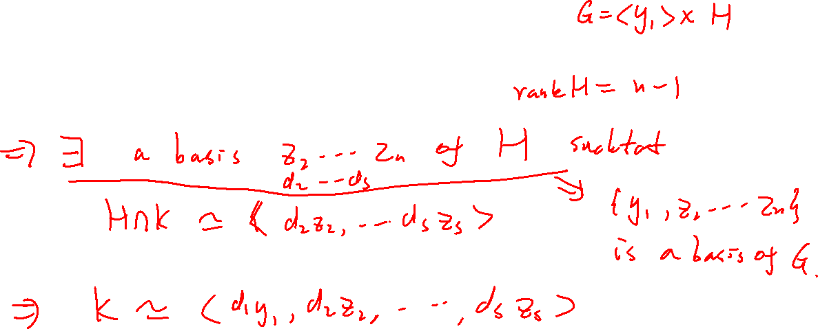
Apply the induction hypothesis.

Slide 27
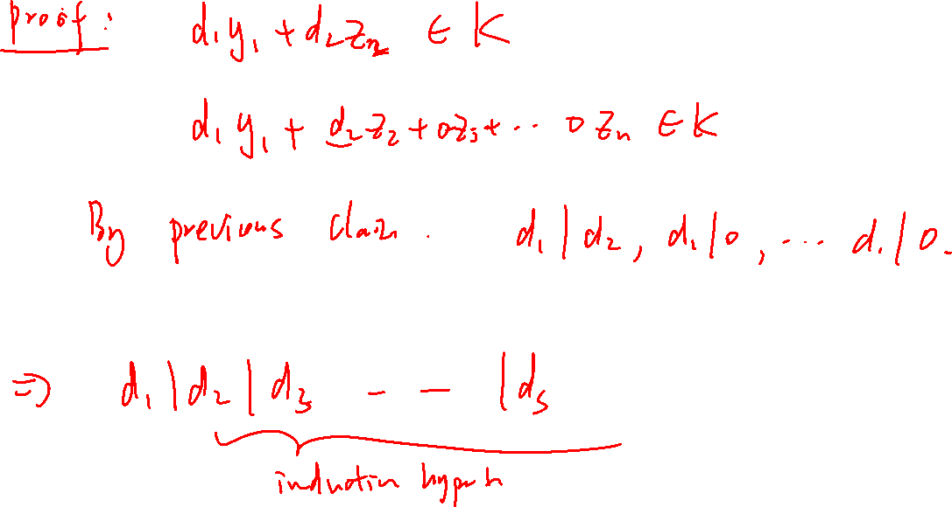
Claim: $d_{1}| d_{2}$

Slide 28
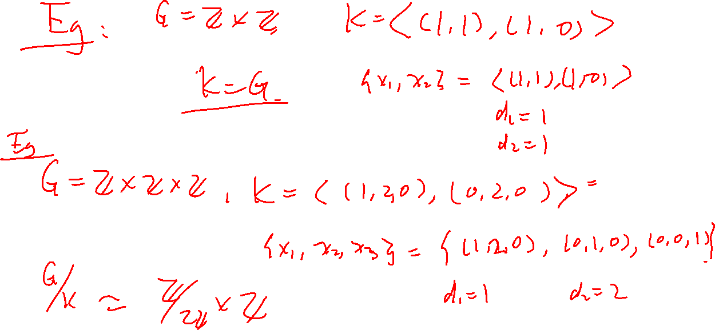

Slide 31
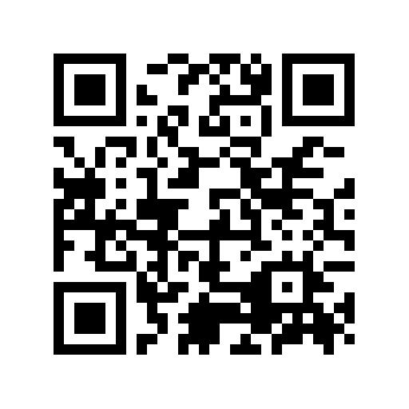
Quiz

